Slide 1
SEO BASICS
WORKSHOP BY KELLY DIELS
KELLYDIELS.COM

Slide 2
I live and work on the traditional and un-ceded territories, past and present, of the Sto:lo Nations
KELLYDIELS.COM

Slide 3
It’s not complicated.
It’s boring
and always needs to be done.
SEO is just housework for your blog
KELLYDIELS.COM

Slide 4
SEO First Principles:
Start with your message
It’s a culture-making move
KELLYDIELS.COM

Slide 5
SEO First Principles:
1) Start with the Message
Write organically
Then decide a keyword/keyword phrase
Go back into your blog post and add the keyword to copy & metadata (“optimize for SEO”)
KELLYDIELS.COM

Slide 6
SEO First Principles:
2) It can be a culture-making move
It’s meant to build online “authority”
Use it to build your power
Use it to interrupt unjust power
KELLYDIELS.COM

Slide 7
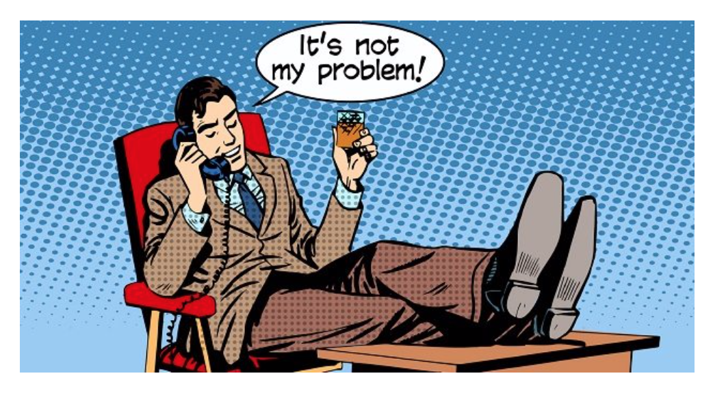
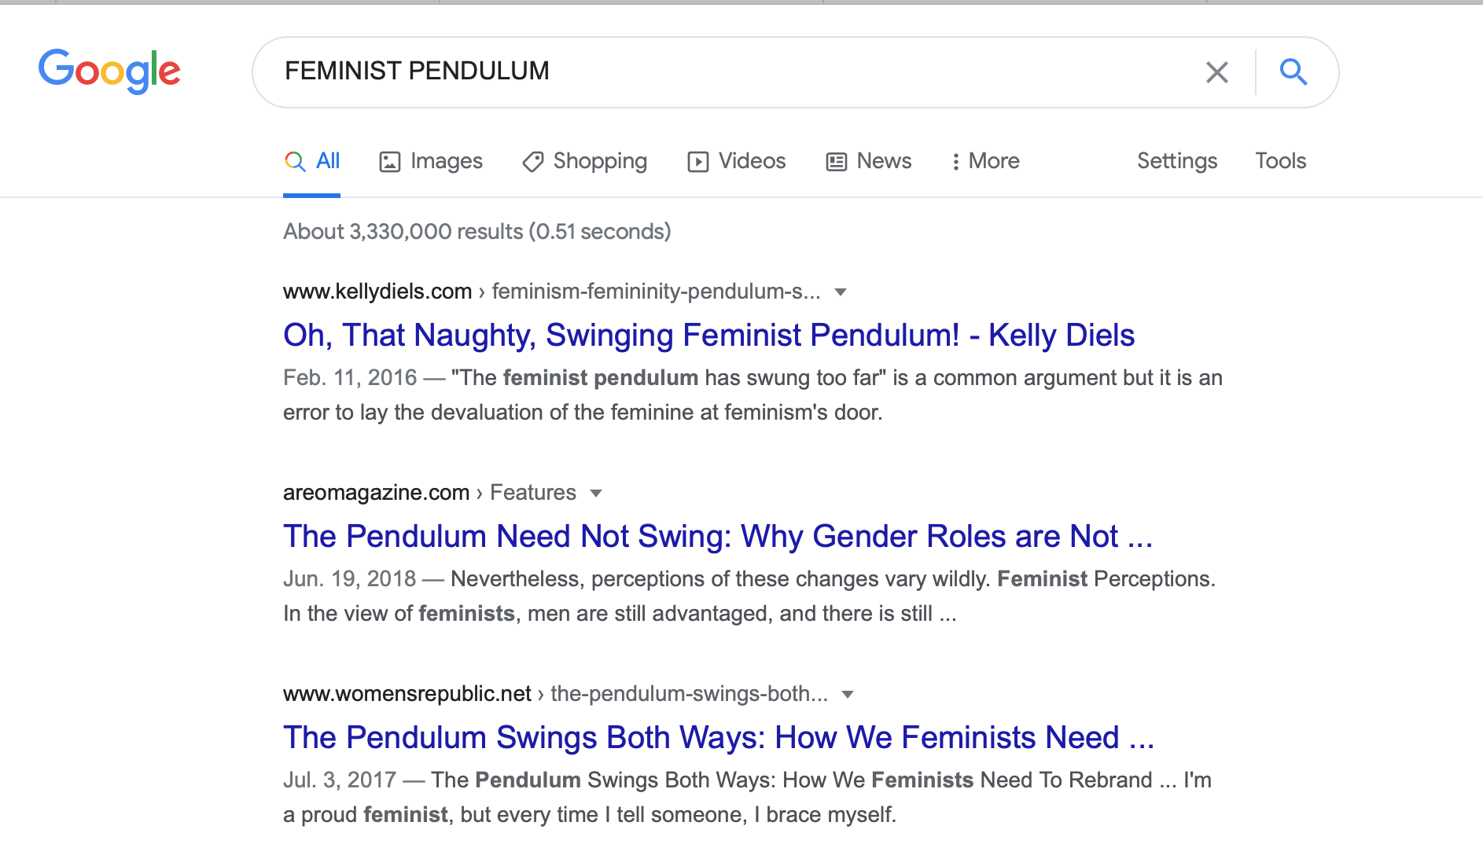
KELLYDIELS.COM
Fun Fact
SEO can be used for resistance and culture-making
(and business-building, if you’re into that sort of thing)
YOUR SUBHEADING HERE
KELLYDIELS.COM

Slide 8
KELLYDIELS.COM
1
2
3
Body Copy
Meta-data
Image

Slide 9
KELLYDIELS.COM
SEO Elements
YOUR SUBHEADING HERE
KELLYDIELS.COM

Slide 10
KELLYDIELS.COM
1. SEO Title
2. Meta Description
YOUR SUBHEADING HERE
3. Slug
KELLYDIELS.COM

Slide 11
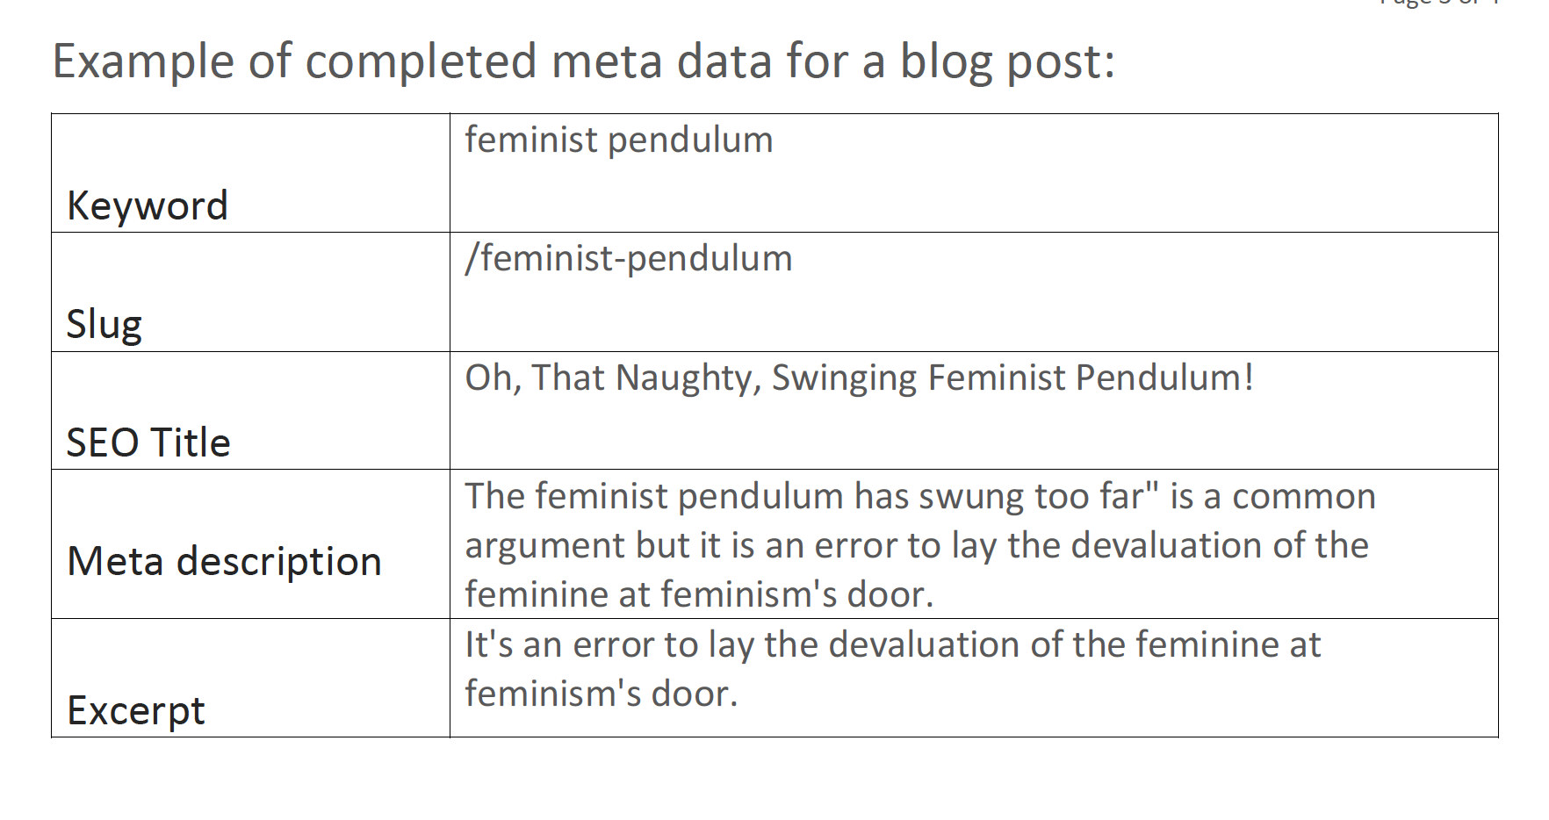
KELLYDIELS.COM
How I Did It
YOUR SUBHEADING HERE
KELLYDIELS.COM

Slide 12
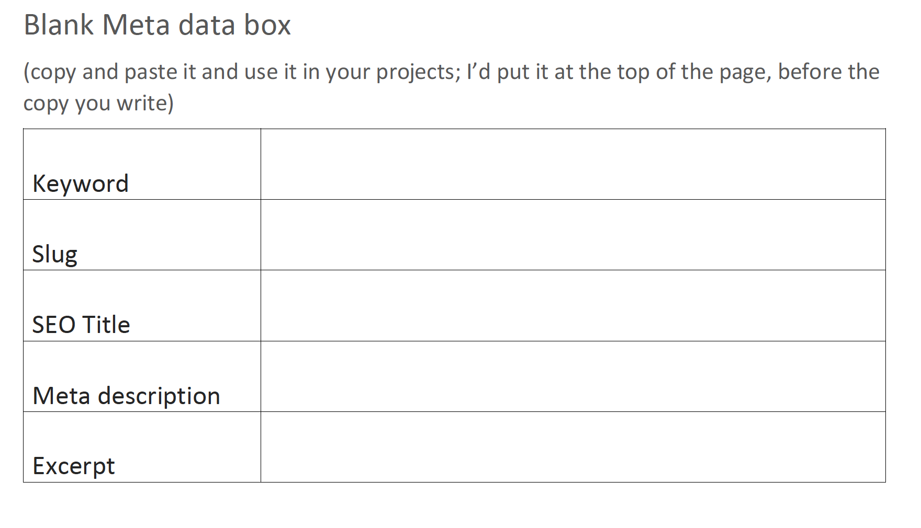
KELLYDIELS.COM
Post-Blog Housekeeping
70 characters
YOUR SUBHEADING HERE
Max 300 characters
KELLYDIELS.COM

Slide 13
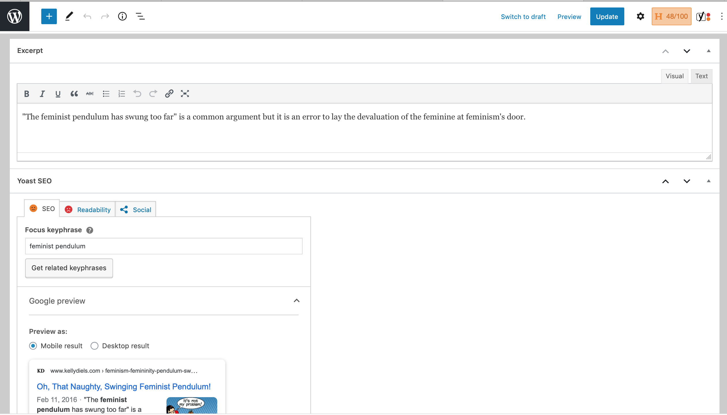
KELLYDIELS.COM

Slide 14
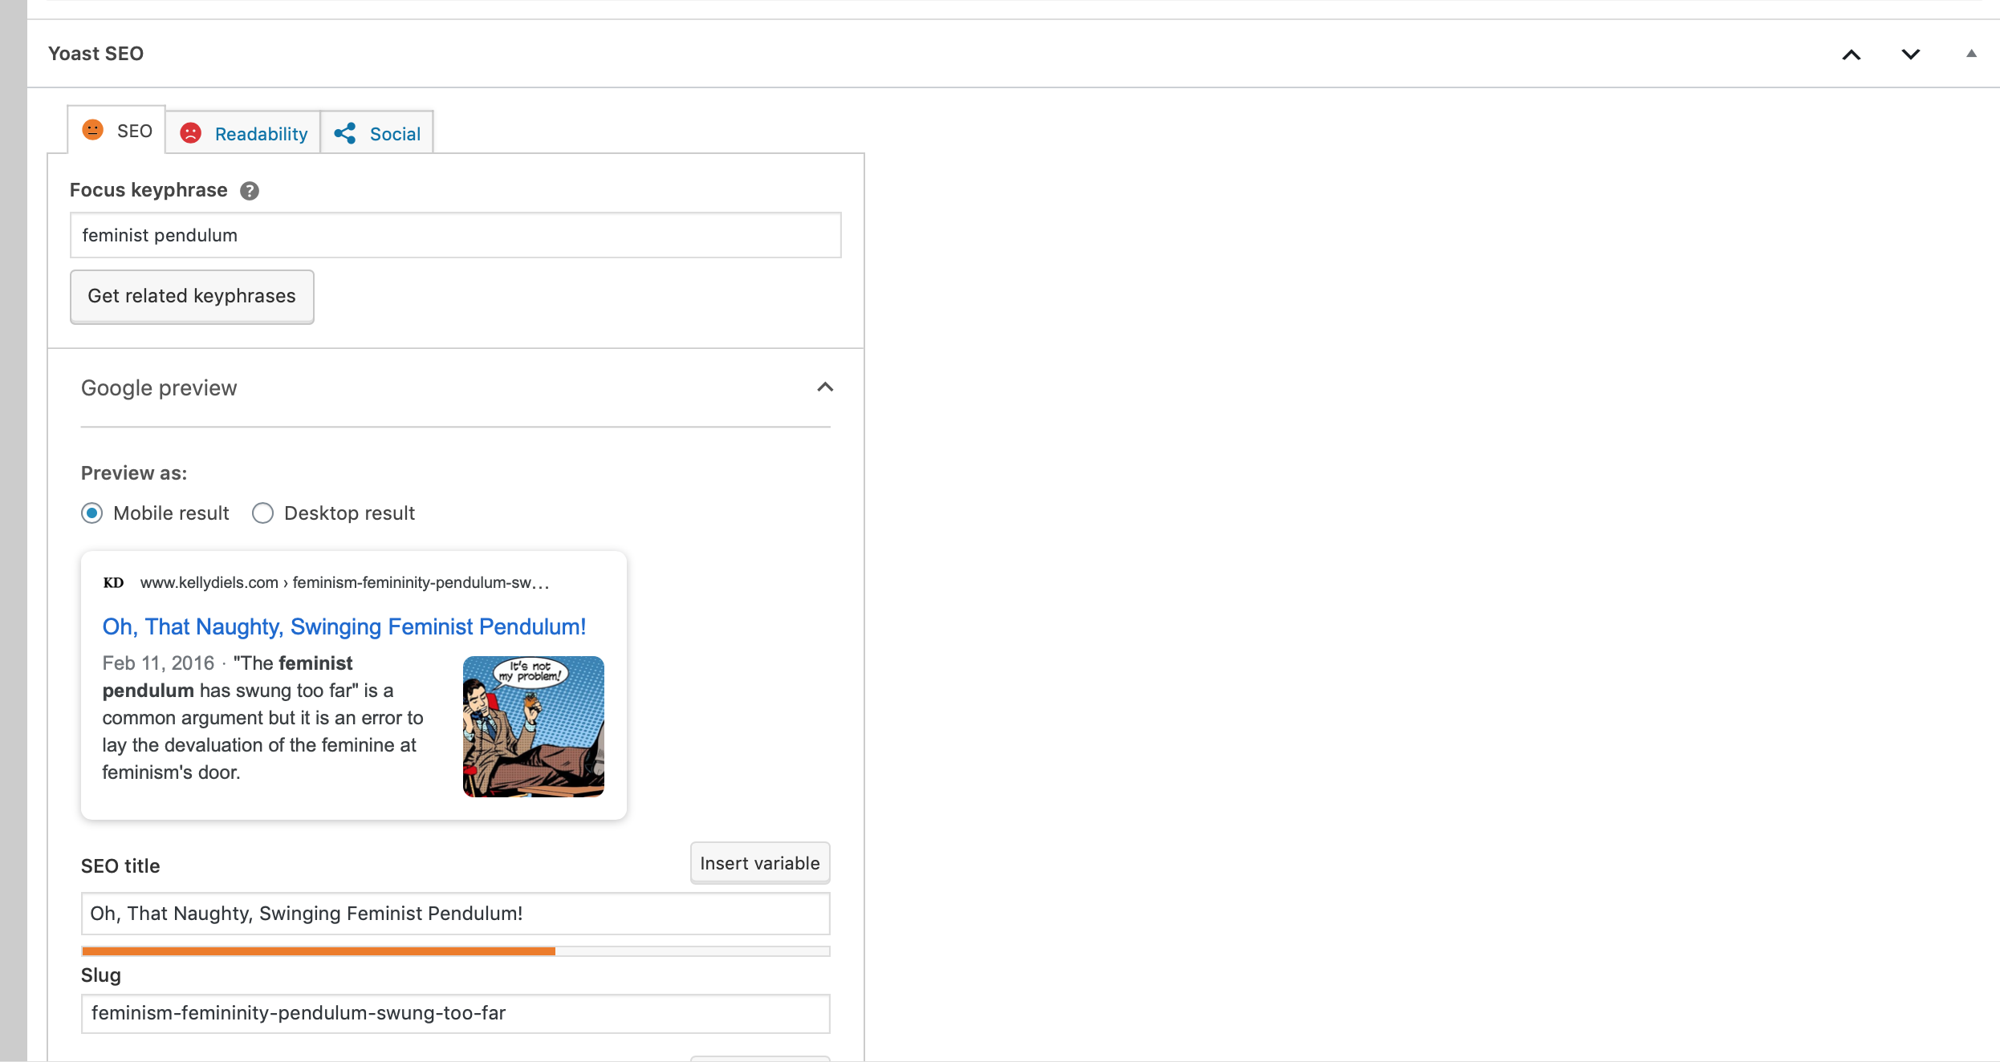
KELLYDIELS.COM

Slide 15
KELLYDIELS.COM

Slide 16
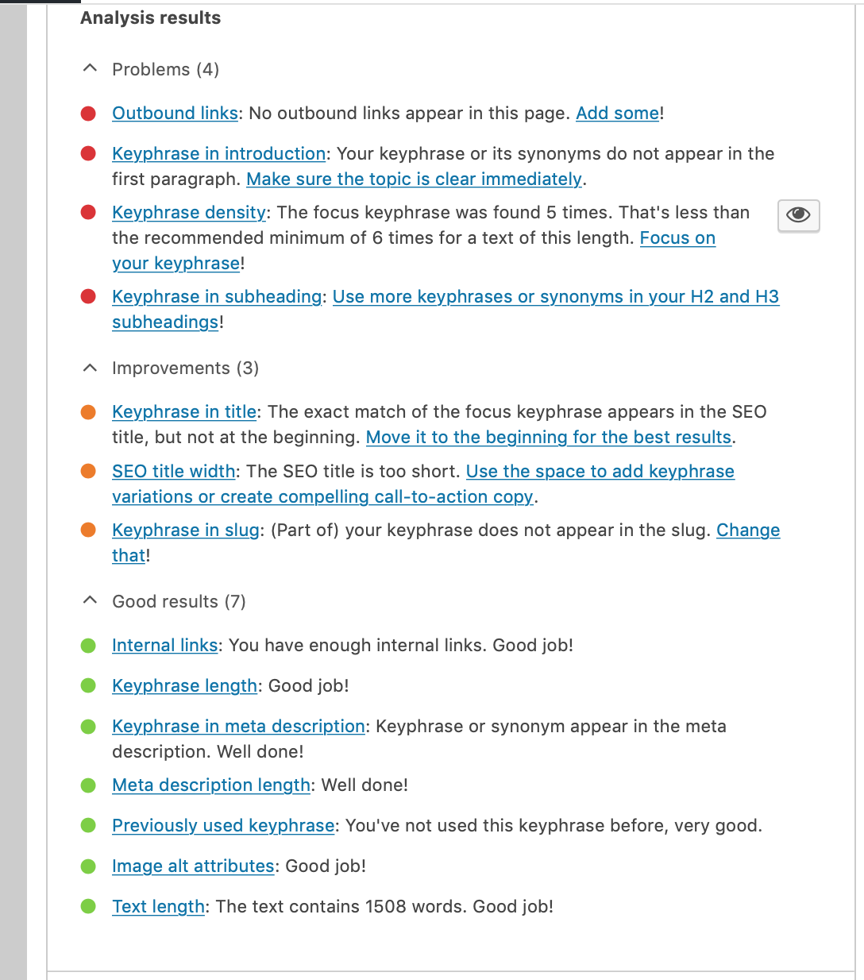
KELLYDIELS.COM

Slide 17
In Addition…
Use keyword IMMEDIATELY, in the first sentence/paragraph
Use keyword in H1 and H2 headings (and subheadings)
Use keyword as the first word in the title
Use outbound links
Keyword density: 1-2% eg once per every 100 words
DEFINE THE ALT TEXT IN YOUR IMAGE
KELLYDIELS.COM

Slide 18
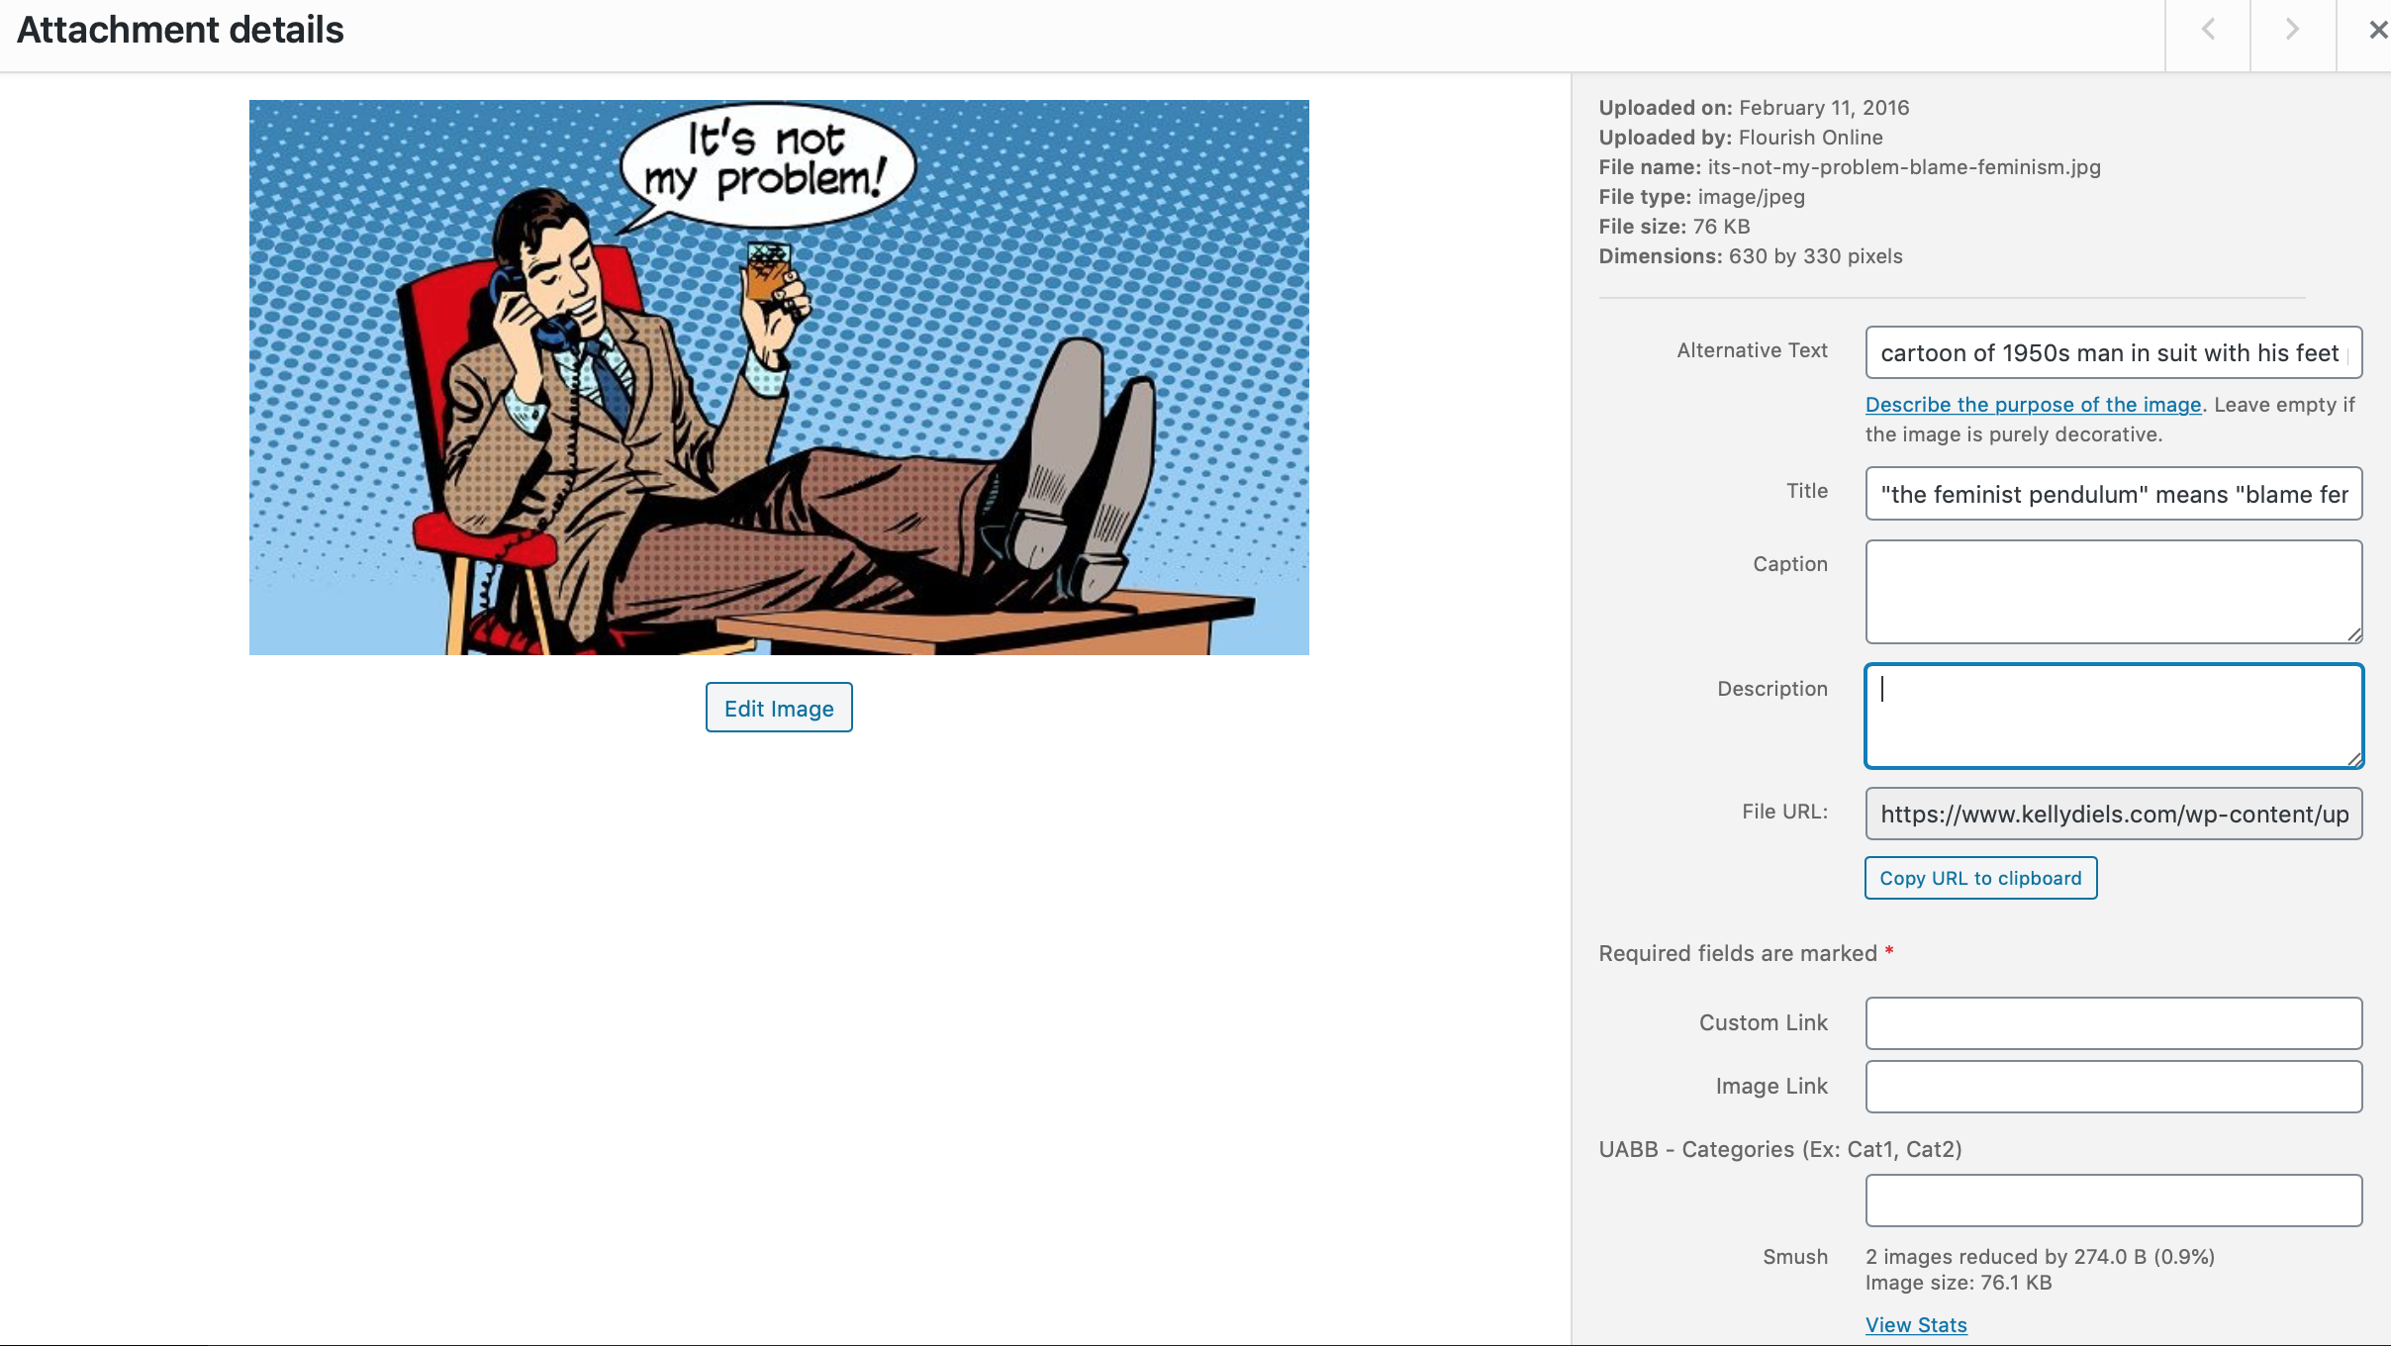

Slide 19
KELLYDIELS.COM

Slide 20
Google and Yelp 5-star reviews are MAGIC
Very long blog posts
Older content
Social Media
Outbound links
Inbound links
Podcasts
Also Useful
KELLYDIELS.COM

Slide 21
KELLYDIELS.COM
7 SEO ESSENTIALS
SEO Title
Metadata
Slug
Alt text on image
Headers
Intro
Body Copy 1-2%
YOUR SUBHEADING HERE
KELLYDIELS.COM

Slide 22
KELLYDIELS.COM
1
2
3
Body Copy
Meta-data
Image

Slide 23
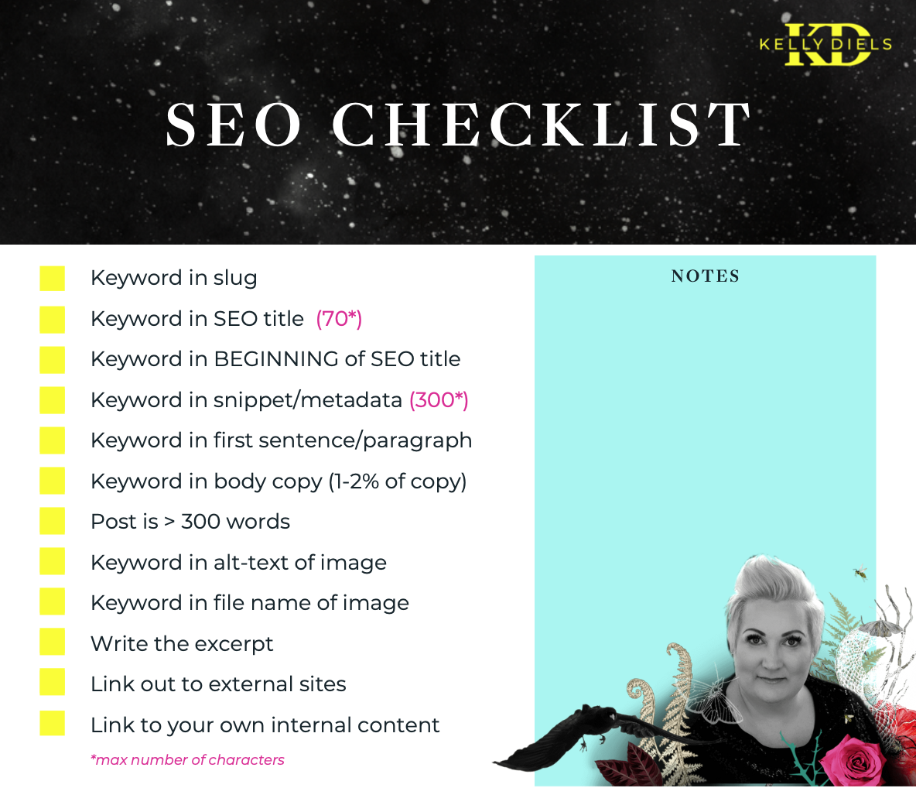
KELLYDIELS.COM

Slide 24
Write organically
Then optimize for SEO
My #1 Tactic
KELLYDIELS.COM

Slide 25
I will share my slides
I will give you the SEO Checklist(pdf)
Recording
https://yoast.com/keyword-research-tools/
Resources
KELLYDIELS.COM

Slide 26
THANK YOU!
SEO Basics Workshop
KELLYDIELS.COM

